Slide 1
AIRLINE TICKET FARE PREDICTION

Slide 2




TEAM 8
Sushma Sindhe
Team Lead
Harshitha Vejella
Storytelling and Data Visualization
Lakshmi Sai Kishore Savarapu
Data Scientist
Phanideepak Gaddam
Data Collection and Preprocessing

Slide 3
INTRODUCTION
The Airline industry is a significant component of the global travel and transportation sector. It encompasses the buying and selling of airline tickets for passenger travel, both domestic and international. Travelers look for best deals and the Airlines try to make profit by selling their tickets. As the industry evolves, building a flight ticket fare prediction model will be a valuable tool for travelers and the airline industry. These models can benefit both consumers looking for the best deals and airlines striving to optimize their pricing strategies.

Slide 4
Challenge
How to predict the price of an Airline ticket based on certain features?
Airline ticket prices are influenced by a multitude of factors, making them a complex and dynamic pricing challenge. However, with the power of data and machine learning, we can create models that provide accurate fare predictions. As the industry evolves, these models can adapt to changing market dynamics, ultimately benefiting both consumers and airlines.

Slide 5
Solution
Data science and machine learning have a wide range of applications across various domains and industries. These technologies have the potential to extract valuable insights, make predictions, and automate tasks, leading to improved decision-making and efficiency. Predicting airline ticket fares is a complex task that involves multiple variables and factors. Data Science and Machine learning techniques can be used to build an effective solution for predicting airline ticket fares.

Slide 6
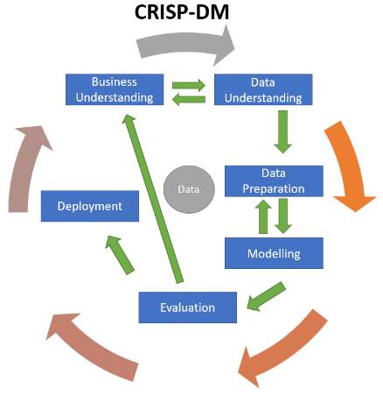
USER STORY
SERVER END WORK
User Story
As a User, I should be able to book a flight ticket that meets all my requirements
Sub Goal
take in the specifications of the customer and process them to find the solution that meets all or maximum of the specifications
Business Goal
Main Goal
To suggest a flight ticket to the customer
Product

Slide 7
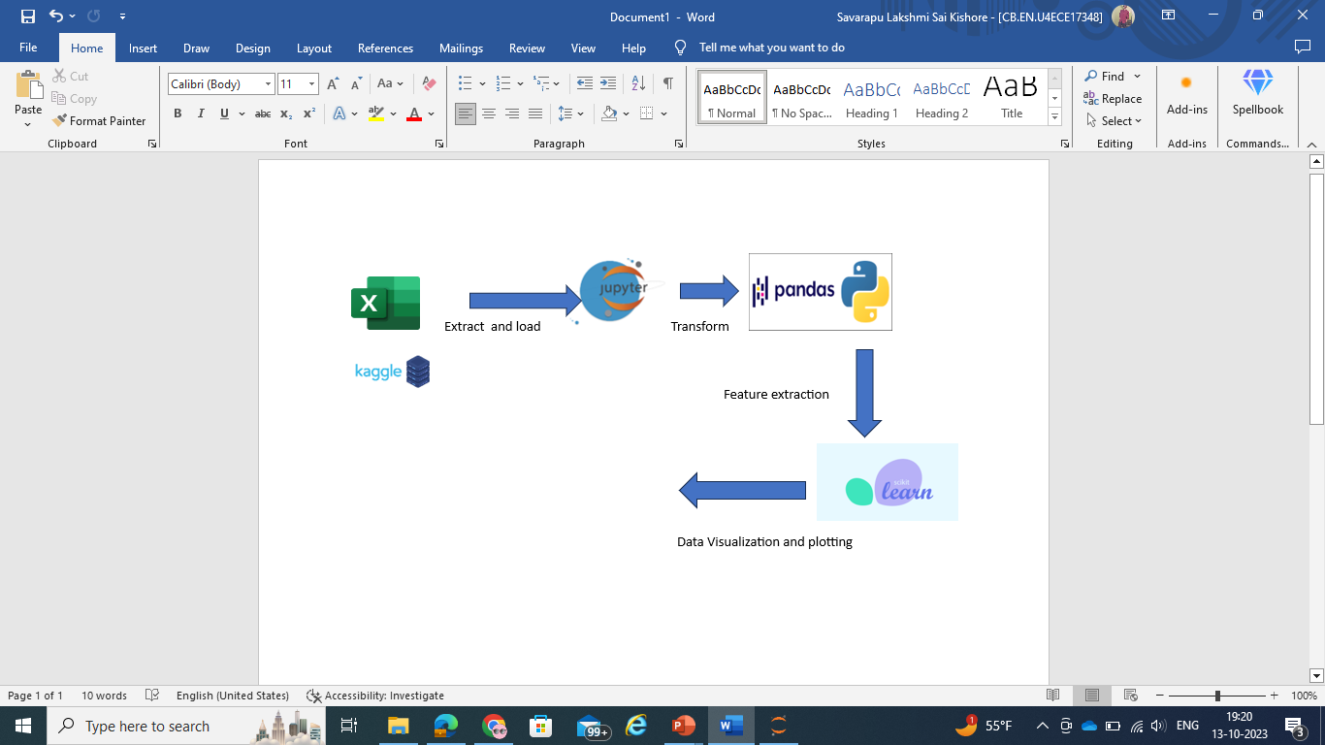
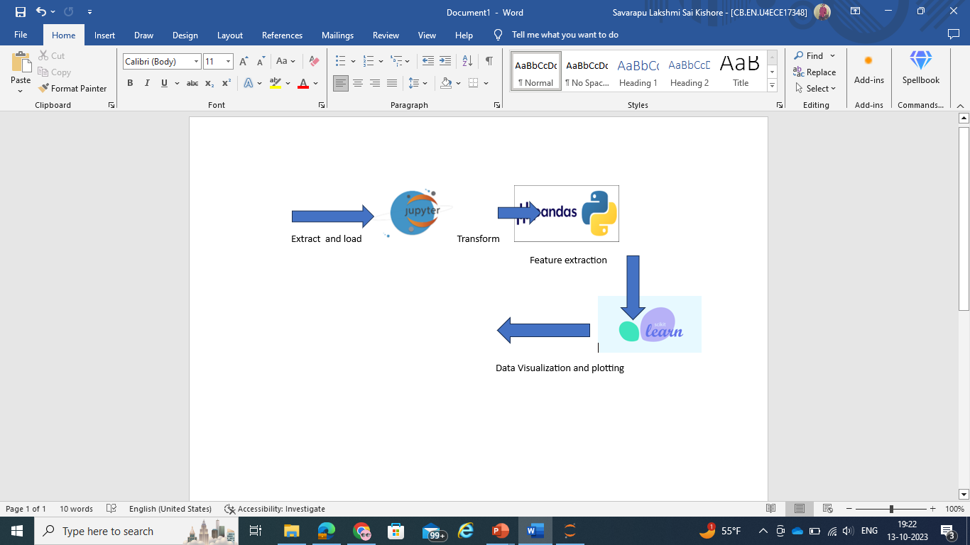
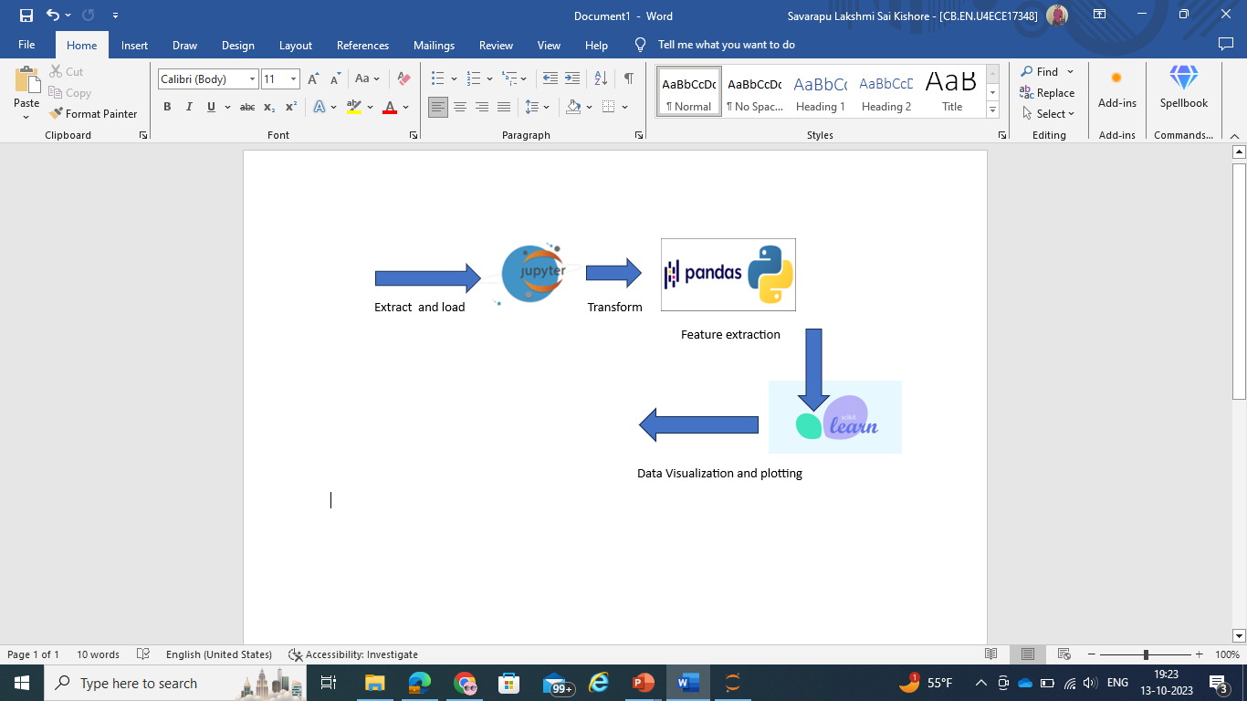

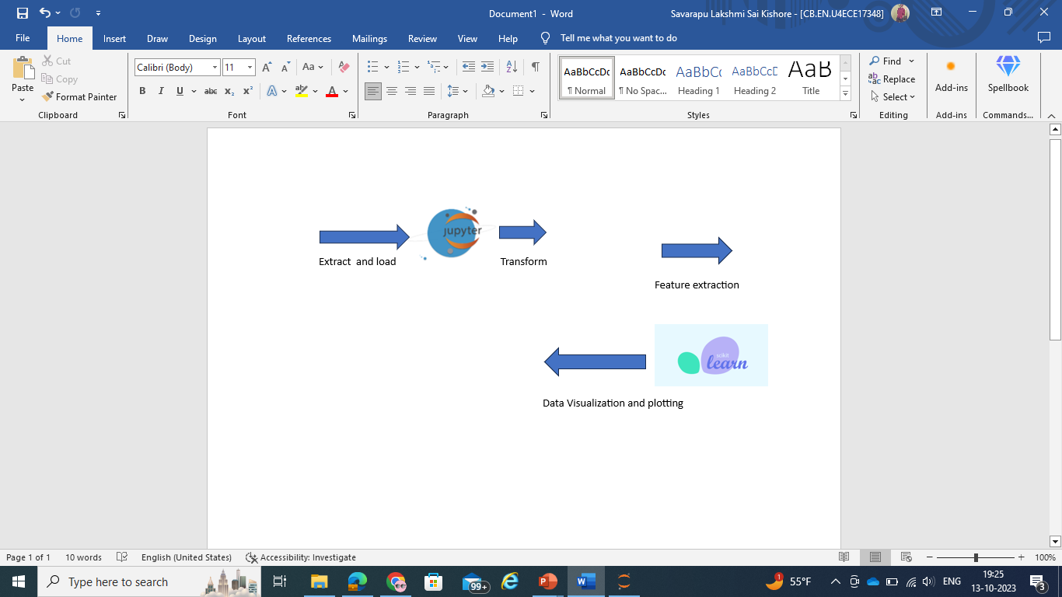

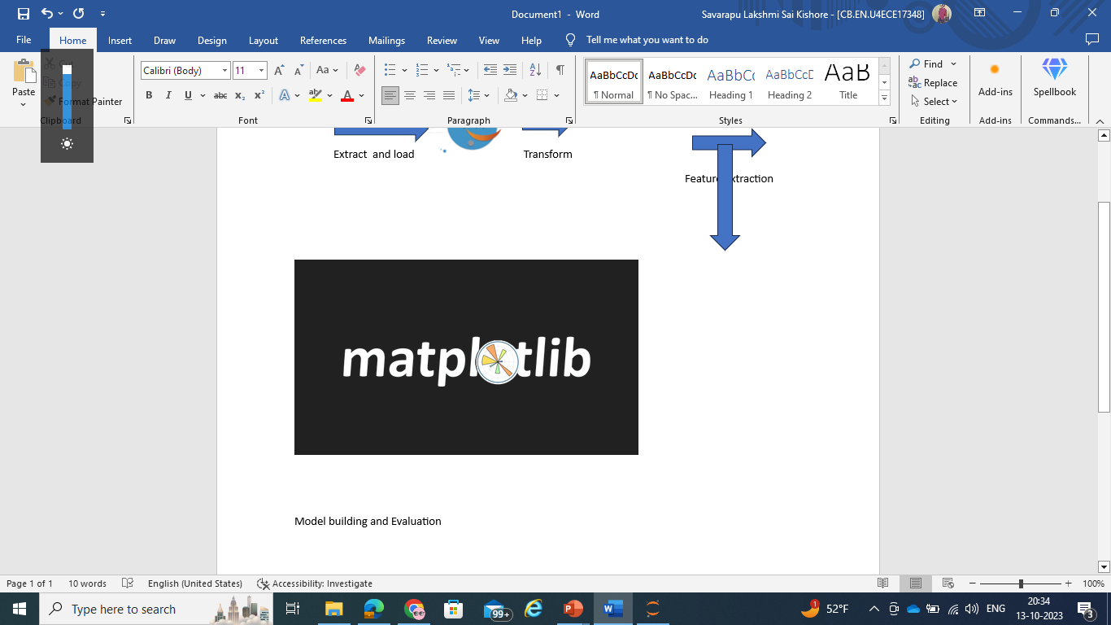
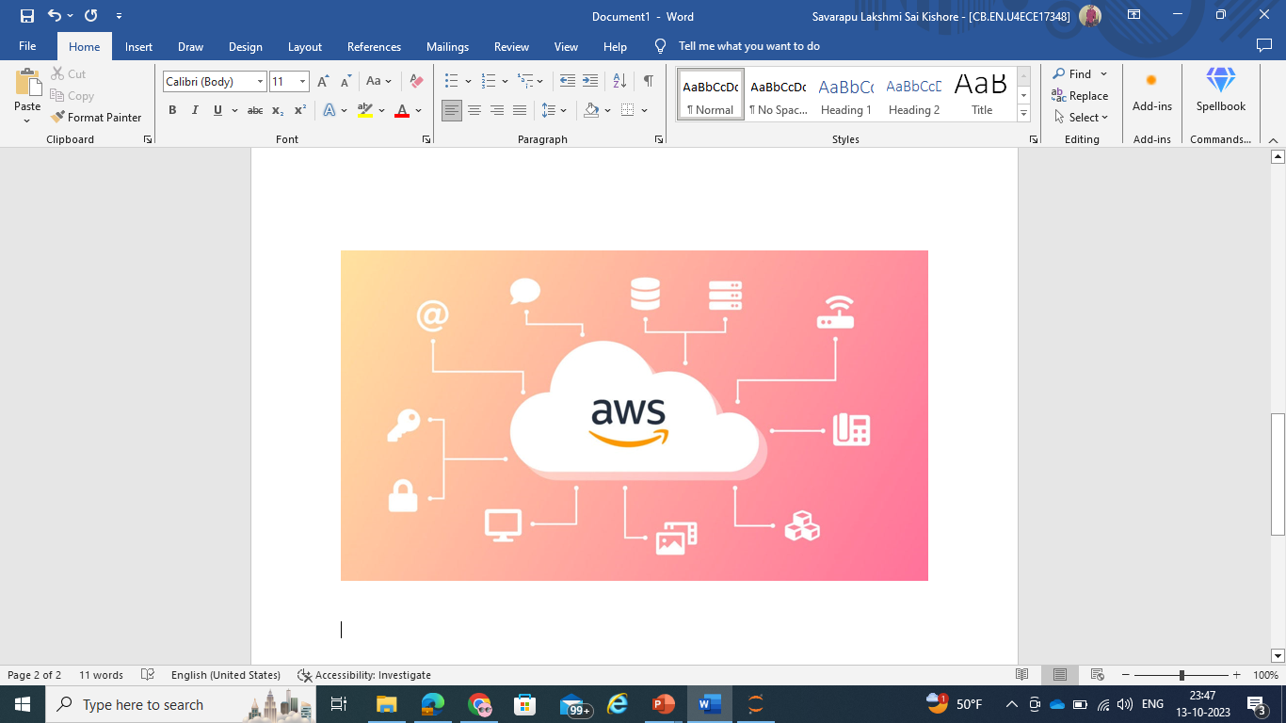
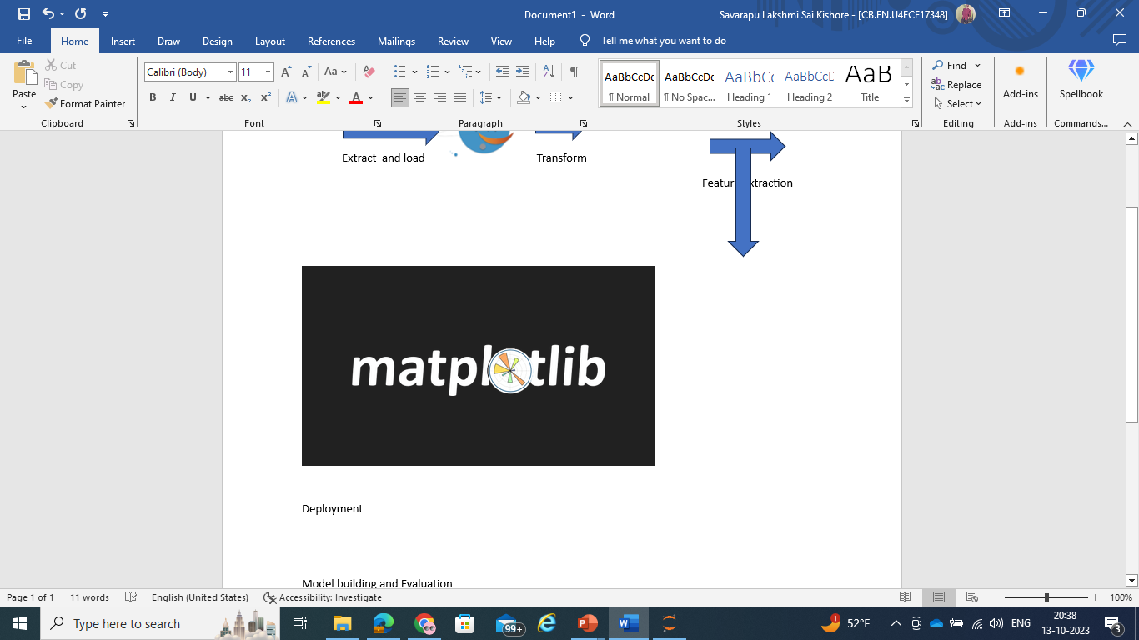
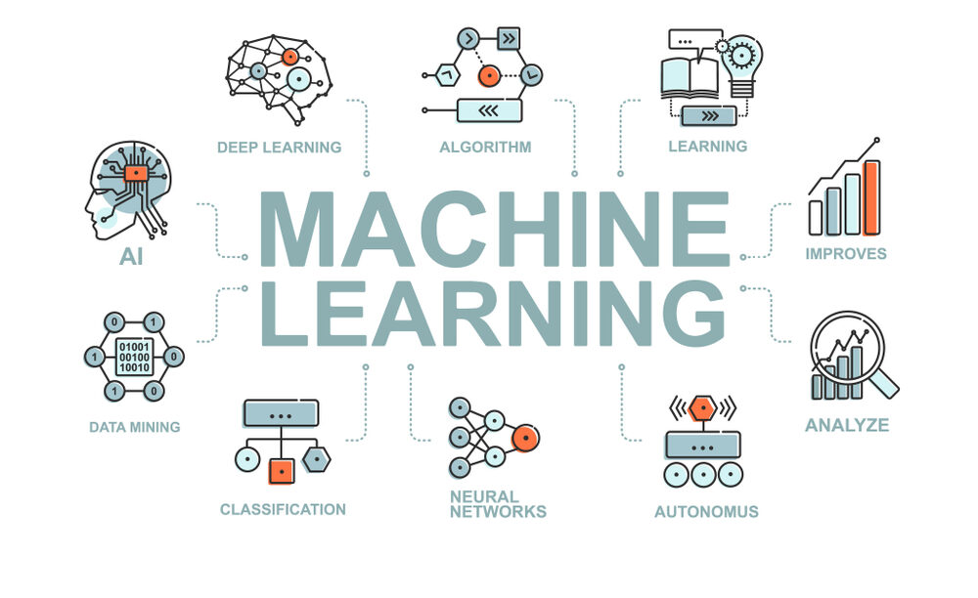
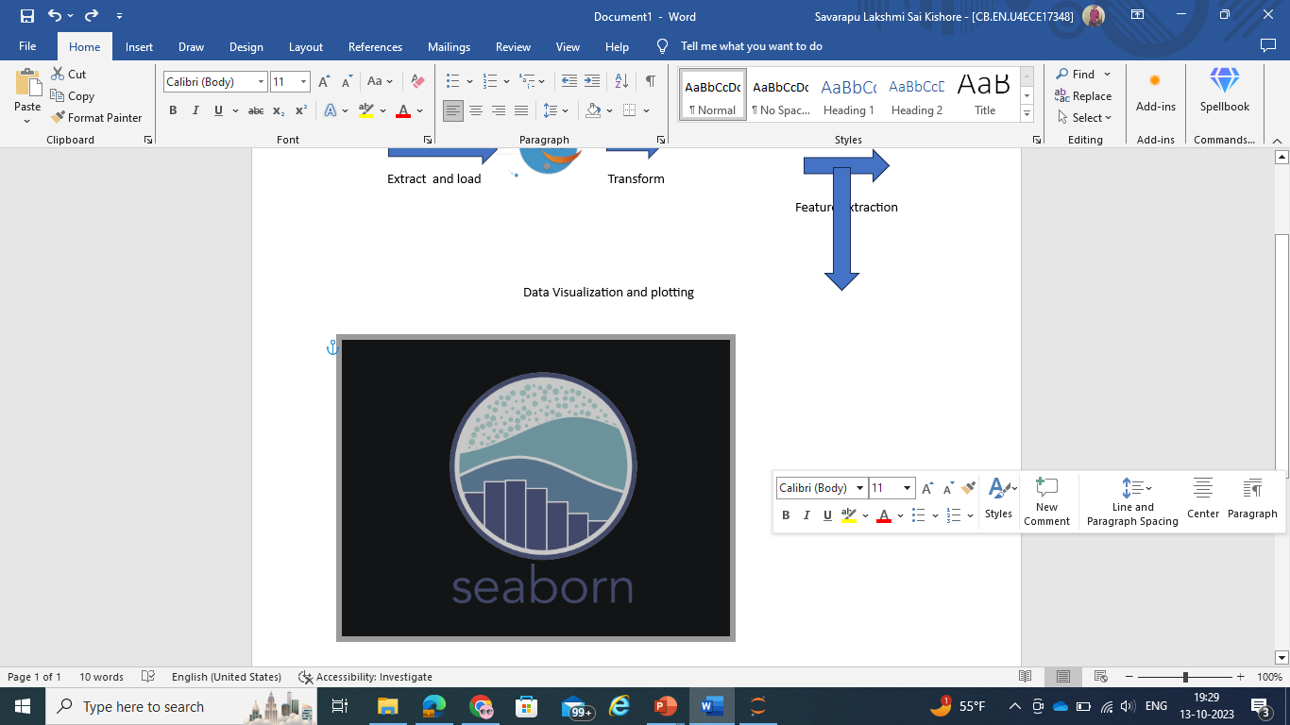
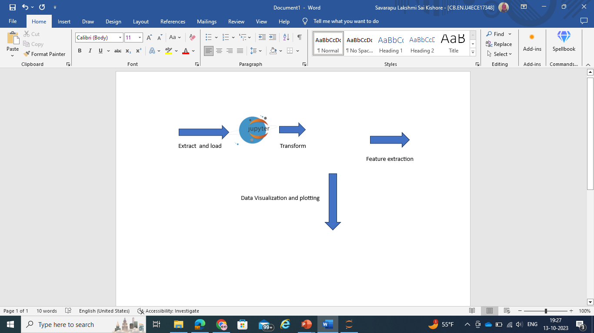

GRAPHICAL VIEW OF THE Proposed MODEL

Slide 8
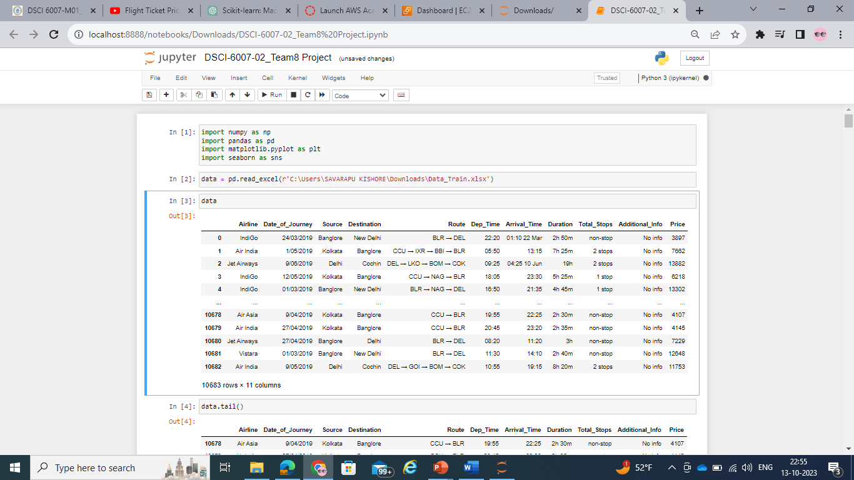
Dataset from Kaggle
https://www.kaggle.com/datasets/nikhilmittal/flight-fare-prediction-mh
Volume: 10683 samples of data
Variety: Structured Data
Velocity: Data generated during the pre covid period
Veracity: Kaggle is said to be the trusted go to point of information
Value: Data can be used to estimate domestic flight fares in India

Slide 9
Tools to be used
Data is collected from Kaggle and stored in Github account for usage and access to the team (Data Storage).
Data is then ingested into Jupyter python notebook (Data Ingestion).
Python libraries such as numpy, matplotlib, sklearn, pandas, seaborn etc are imported for pre-processing and feature extraction on the data (Data Processing).
Machine Learning models are built using the dataset and are evaluated.
Model and the dataset are stored in Github and AWS for accessibility to data scientists, analysts and end users (Data Consumption).
AWS is used to host the end user web application.

Slide 10
MODELS TO BE USED
Data Engineering pipeline is applied through out the process to ensure perfect execution.
5 V’s of Data is checked to ensure right set of data is collected for the problem statement.
Data Preprocessing is carried out to ensure no noise or bias or outliers are present in the data.
Feature extraction is performed to transform categorical variables and non numeric values so that the Machine Learning model can understand.
Linear Regression and Random Forest Regressor models are build using the dataset.
Models are evaluated by calculating errors and accuracy.
Models are deployed successfully.

Slide 11
references
https://youtu.be/WjLou_0YVMo?si=O_MsRoI5q4ooTXeC
https://youtu.be/46bRwRvW0PI?si=KIchjcJvDOZkfBMq
https://youtu.be/KFPX0FLhscs?si=VSFVpvoKYssh3epv

Slide 12
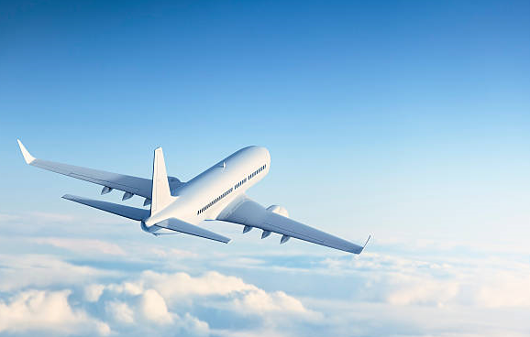
Thank You and Have a Safe Flight!

